Slide 1
Vitoshya Store
Website Content

Slide 2

Web Pages on Our Website
Home Page
Invitation Cards
Wedding
Birthday
Special Occasion
E-Invitation
Cards
Videos
Wedding Boxes
Gifts
Our Reach
Help
About

Slide 3
CONTENT OF HOME PAGE

Slide 4
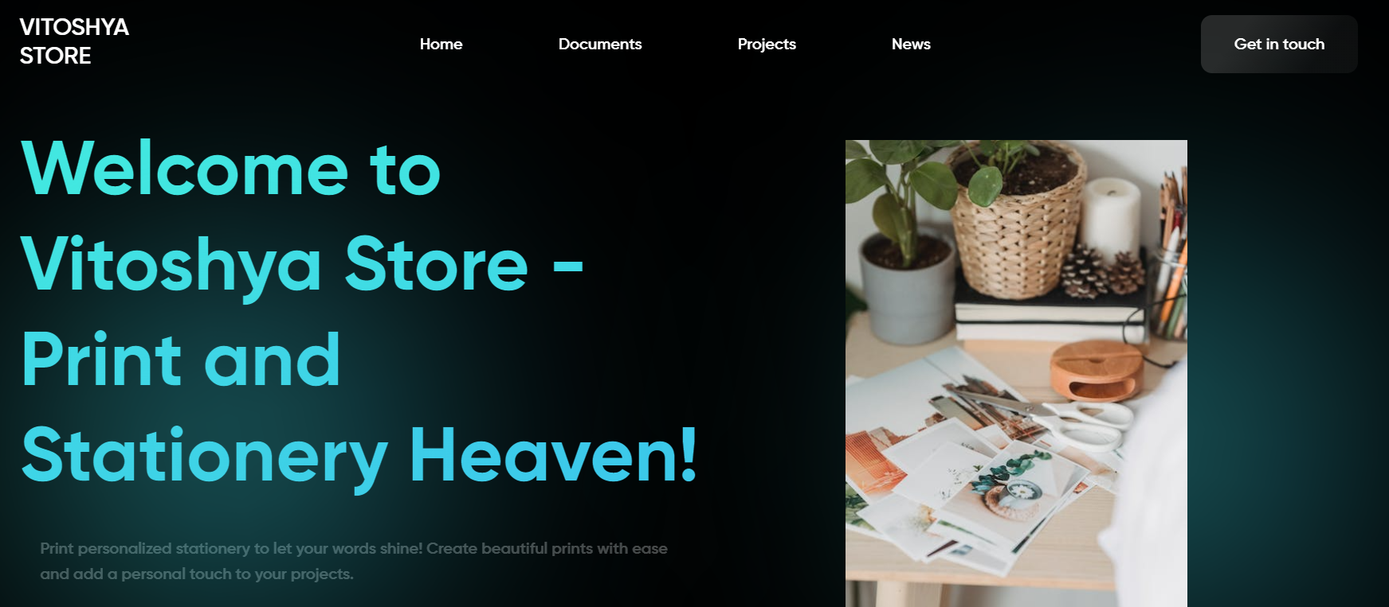
Home
Invitation Cards
E- Invitation
Wedding Boxes
Gift
Help
Our Reach
About
Get in Touch
Welcome to Vitoshya Store – Your Destination for Elegant Invitations and Perfect Gifts!
At Vitoshya Store, we know that your special occasions deserve to be celebrated in style. That's why we offer a stunning collection of wedding, birthday, and event invitations that are as unique as you are. Our invitations are carefully designed with exquisite details and customized to suit your individual style, making them the perfect way to set the tone for your special event.
In addition to our invitations, we also offer a wide selection of thoughtful gifts for couples, including personalized keepsakes, and more. Our gifts are designed to celebrate the love and joy of your special occasion and create lasting memories that you'll cherish for years to come.
At Vitoshya Store, we are dedicated to providing exceptional service and a seamless shopping experience. Our team of experts is always available to help you choose the perfect invitations and gifts that will make your special occasion unforgettable.
So why wait? Browse our selection today and discover the perfect invitations and gifts that will make your special occasion one to remember.
Please add some good pictures & colors which provide good look to our wensite.

Slide 5
CONTENT OF OUR REACH PAGE

Slide 6
Our Reach
At Vitoshya Store, we are proud to deliver our products to customers across India, including states such as Uttar Pradesh, Rajasthan, Madhya Pradesh, Delhi, Noida, Bihar, Uttarakhand and more.
We understand that our customers come from diverse backgrounds and locations, and we strive to ensure that everyone has access to our unique and beautiful products. Whether you live in a bustling metropolis or a quiet rural town, we are committed to delivering our products to your doorstep in a timely and reliable manner.
Our team works closely with trusted logistics partners to ensure that your purchases are carefully packaged and delivered with care. We also offer convenient tracking options so that you can keep track of your delivery and stay informed every step of the way.
At Vitoshya Store, we believe that every customer deserves the highest level of service, no matter where they are located. Our commitment to excellence and attention to detail is reflected in every aspect of our delivery process, and we are proud to serve customers throughout India.
Thank you for choosing Vitoshya Store – we look forward to delivering beautiful products to your doorstep!
Please add india’s map which shows reached states.

Slide 7
CONTENT OF ABOUT
PAGE

Slide 8
About Page
Welcome to Vitoshya Store – Where Memories Begin
At Vitoshya Store, we believe that life's most special moments should be celebrated in style. That's why we offer a carefully curated selection of wedding, birthday, and event invitations, as well as unique gifts and keepsakes that will help you create lasting memories with your loved ones.
But our mission doesn't stop there. We are also committed to providing exceptional service and convenience to our customers, which is why we offer a reliable delivery service that brings your purchases directly to your doorstep. Whether you're purchasing an invitation for your special event or a gift for your loved ones, we want to make your shopping experience as seamless and hassle-free as possible.
Our bulk delivery service is perfect for event planners, businesses, and individuals who need a large quantity of invitations or gifts for their special occasion. We understand the importance of timely and efficient delivery, and we work closely with our customers to ensure that their orders are delivered on time and in perfect condition.
Our passion for design and attention to detail are reflected in every aspect of our store, from our elegant invitations to our beautiful selection of gifts. We are committed to providing exceptional quality and craftsmanship, and we work with the best designers and artists to ensure that our products are both beautiful and functional.
But our mission goes beyond just selling products. We want to help you create memories that will last a lifetime, and we do that by providing exceptional service and support at every step of your journey. From helping you choose the perfect invitations to finding the ideal gift for your loved ones, we are always here to make your special occasion unforgettable.
Thank you for choosing Vitoshya Store – we look forward to helping you create memories that will last a lifetime!

